Slide 1
CAD DESIGNS
Using Autodesk fusion 360
Aditya bansal

Slide 2
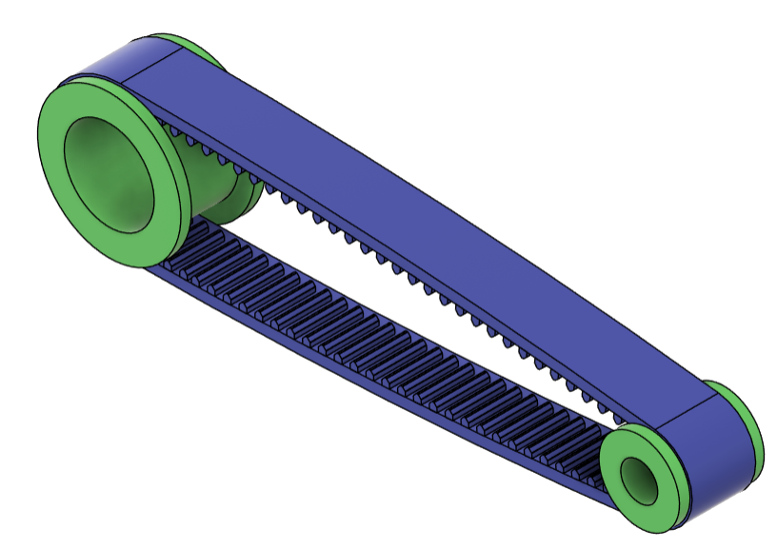
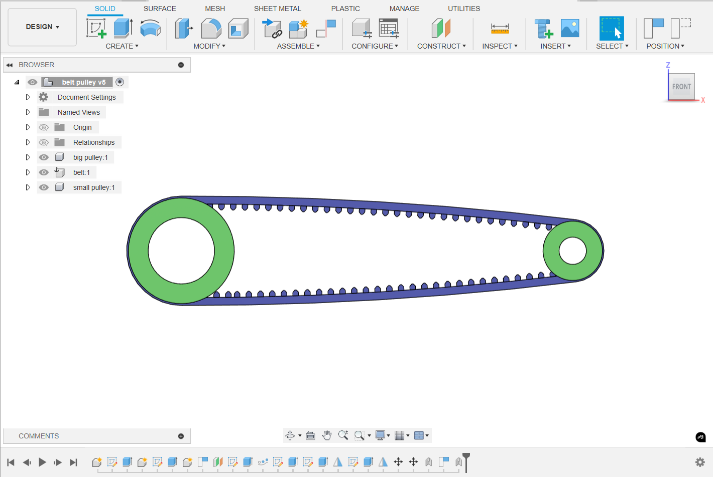
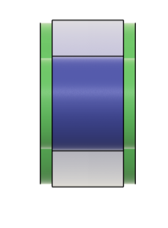
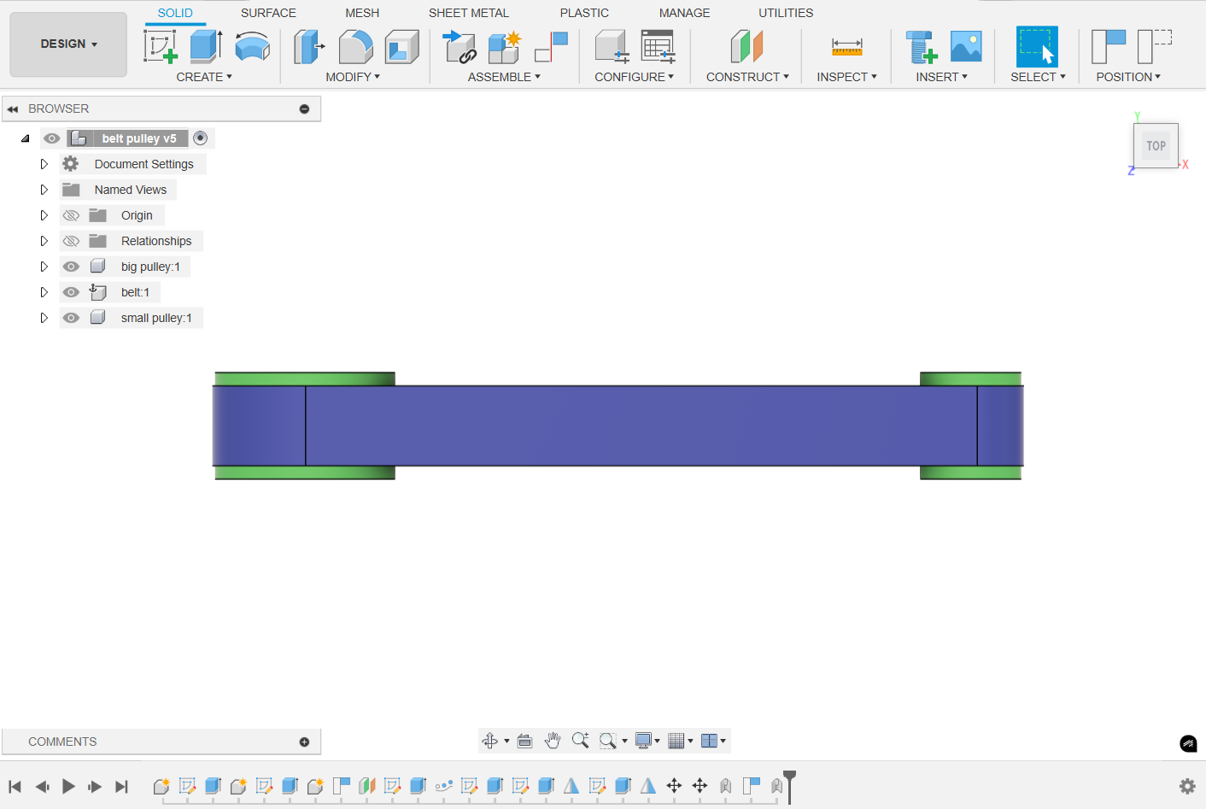
Belt and pulley
Designed a belt and pulley system in Autodesk Fusion 360 by modeling pulleys, defining the belt path, and assembling the components to simulate rotational power transmission. The project improved my understanding of assembly constraints and mechanical motion in CAD.

Slide 3
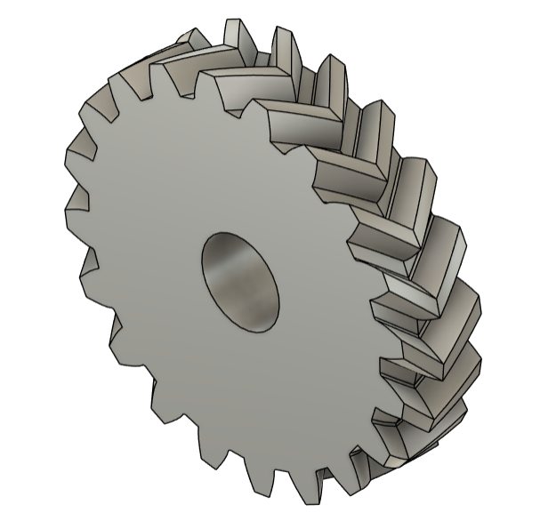
Double helical gear
Designed a double helical gear in Autodesk Fusion 360 with opposing helix angles to balance axial thrust and ensure smooth power transmission. Modeled accurate tooth profiles, applied helical constraints, and assembled the 3D geometry, strengthening my understanding of gear design and load distribution.

Slide 4
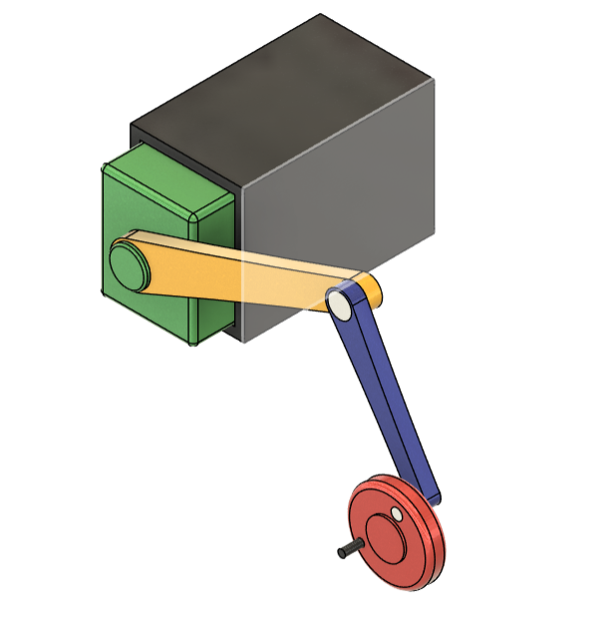
Slider Crank Mechanism
Designed a slider-crank mechanism in Autodesk Fusion 360, modeling the crank, connecting rod, and slider to convert rotary motion into reciprocating motion. Assembled the components with proper motion constraints to simulate kinematic behavior and improve understanding of linkage mechanisms and CAD assembly.

Slide 5
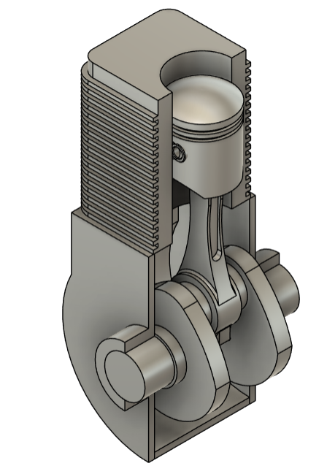
2 stroke engine
I designed a 2-stroke engine model in Autodesk Fusion 360, putting together the piston-cylinder assembly, crankshaft, connecting rod, and ports. It’s pretty neat to see how the model shows a full power cycle in just two piston strokes, packing more punch than a 4-stroke engine.This project was a great way to level up my skills in handling complex assemblies, running motion simulations, and really getting how internal combustion engines work.

Slide 6
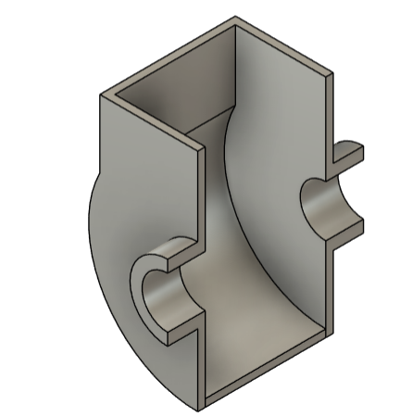
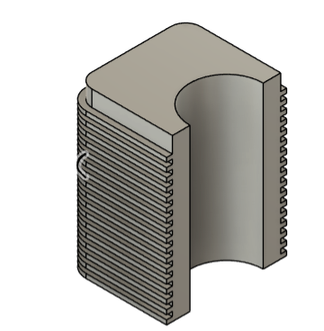
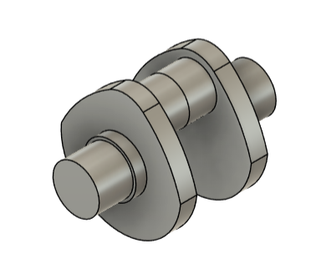
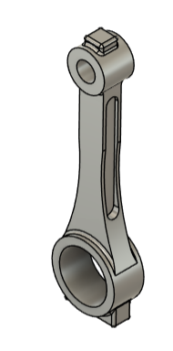
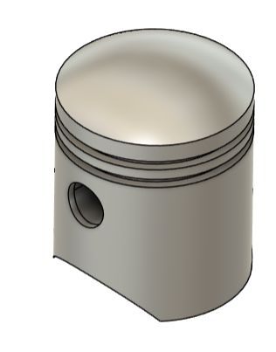
Individual components for 2 stroke engine
Upper part
Lower part
Crankshaft
Piston
Crank

Slide 7
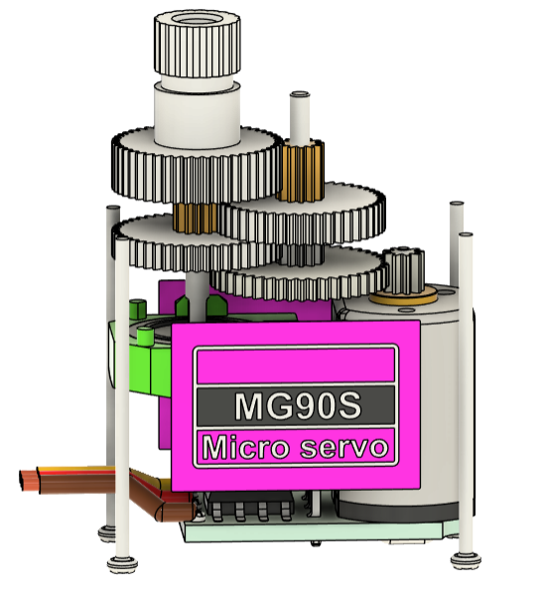
Servo motor
I crafted a servo motor model in Autodesk Fusion 360, building out the casing, rotor, shaft, and gear setup. It’s cool to see how the model captures the compact design of servo motors, which are key for nailing precise angular control in robotics, CNC machines, and automation gear. This project really boosted my grasp of electromechanical parts, sharpened my precision modeling, and leveled up my CAD detailing and assembly design skills.

Slide 8
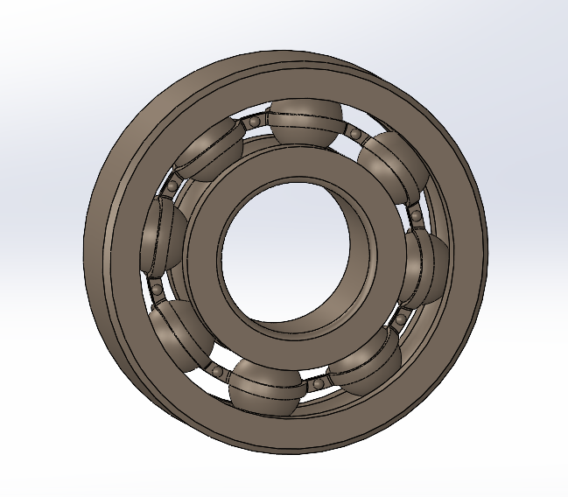
Roller bearing
Modeled a roller bearing assembly in SolidWorks, including the inner race, outer race, rollers, and cage, using precise dimensional relationships. Assembled the components with appropriate mates to simulate rotational motion and verified clearances, alignment, and load distribution within the bearing.

Slide 9
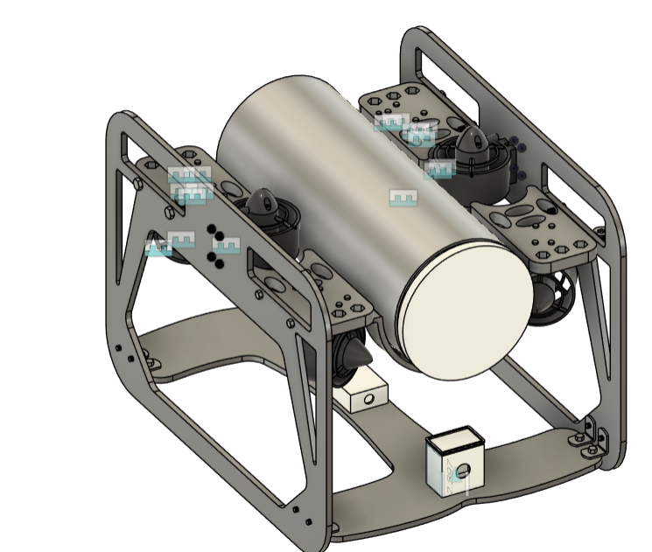
Autonomous UNDERWATER VEHICLE
I'm diving into designing and building an Autonomous Underwater Vehicle (AUV) for Gujarat Robofest 5.0, aiming to create a tough, self-sufficient underwater robot that can navigate, detect objects, and tackle tasks without any human nudging. The design process has me shaping the hull, hooking up the propulsion system, tweaking buoyancy control, and strategically placing onboard sensors to keep the AUV stable and nimble. Using Fusion 360 I’ve put together a detailed 3D model, complete with cutouts for thrusters, sensor mounts, and a snug spot for the electronics.

Slide 10
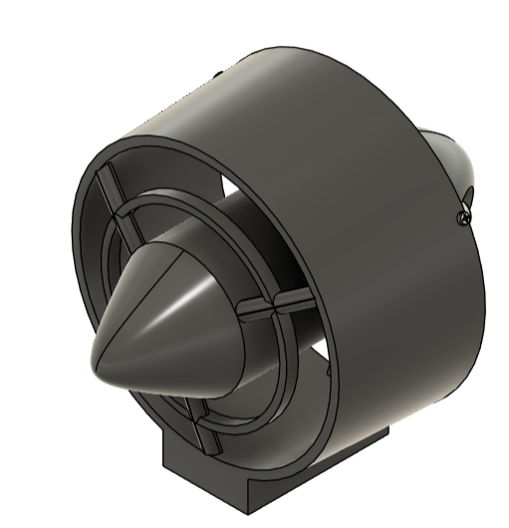
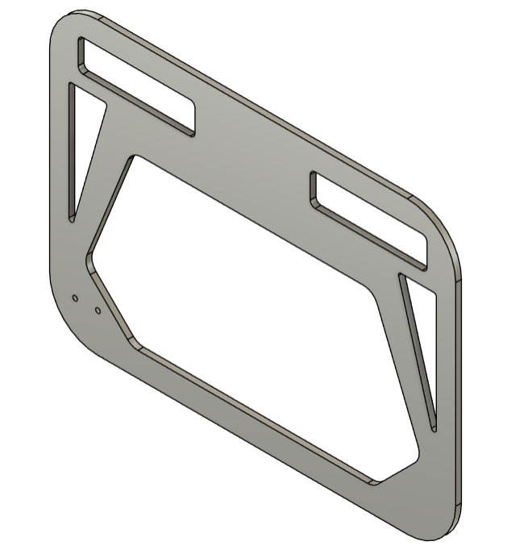
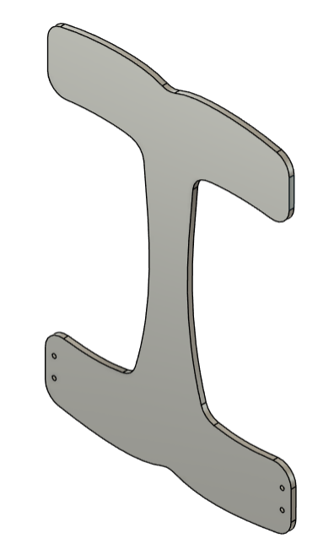
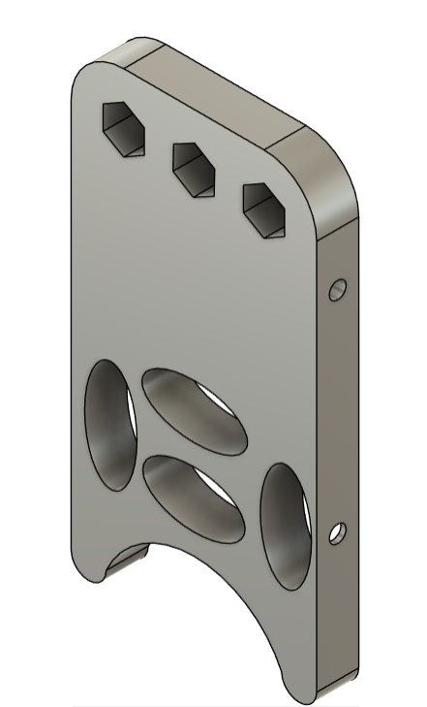
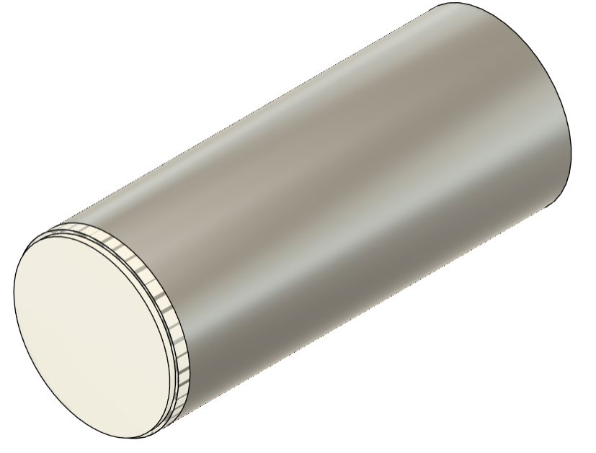
Individual components of auv
Thrusters
Side frame
Base frame
Support for pipe
And buoyancy foam
Electronics pipe

Slide 11
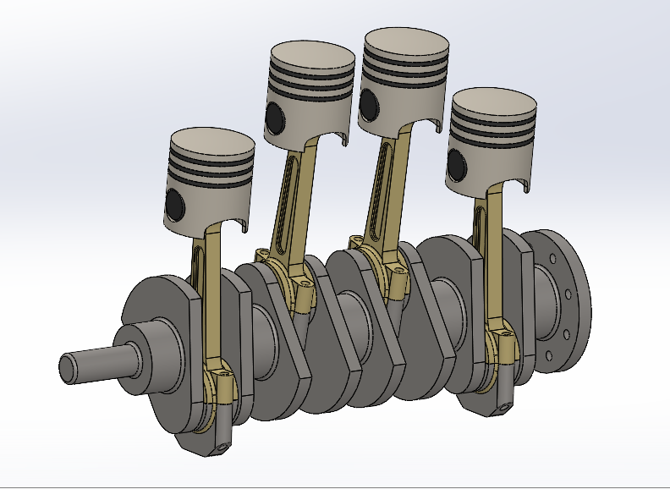
4 cylinder Engine
Designed a four-cylinder engine assembly in SolidWorks, including pistons, connecting rods, and crankshaft, with proper dimensional relationships and motion constraints. Developed each component as individual parts, assembled them using mates to simulate the kinematic motion, and verified clearances, alignment, and overall mechanical functionality of the system.

Slide 12
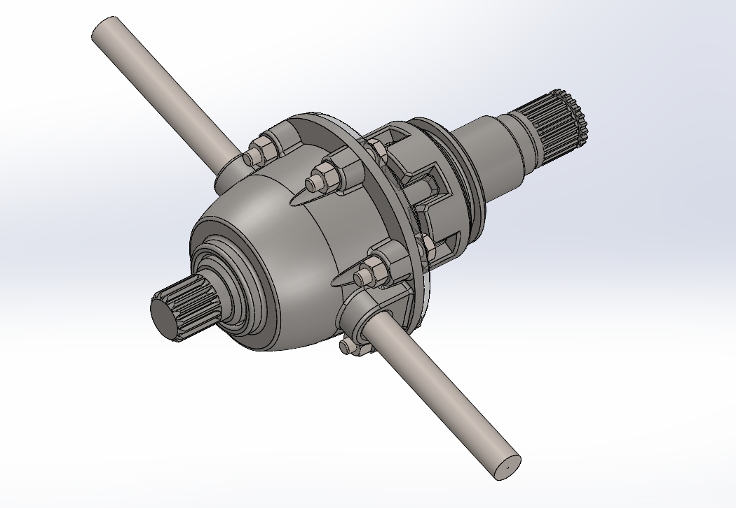
DiffErential
Modeled a differential assembly in SolidWorks, including the ring gear, pinion, side gears, spider gears, and housing, with accurate gear geometry and dimensional relationships. Assembled the components using appropriate mates to simulate power transmission and verified gear meshing, clearances, and rotational behavior of the system.

Slide 13
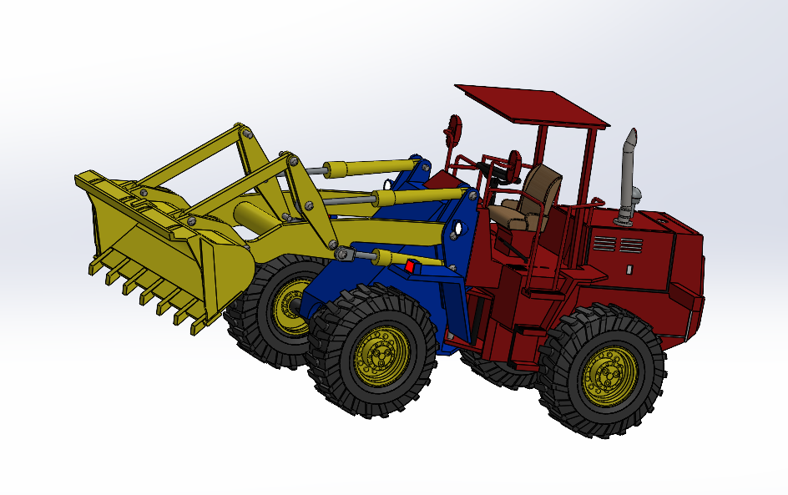
Wheel-loader
Modeled a wheel loader assembly in SolidWorks, including the chassis, bucket, linkage mechanism, and hydraulic cylinder layout. Assembled the components with proper mates to simulate lifting and dumping motions, and verified clearances, articulation, and overall mechanical functionality of the system.

Slide 14
Thank you
ADITYA BANSAL
Contact : +91 – 8619759363
Email : 23ume506@lnmiit.ac.in

